Slide 1
19th March 2014
T. Hashioka
Photosynthesis Equations & Parameters
for MRI.COM-MEM
Shigemitsu, M., T. Okunishi, J. Nishioka, H. Sumata, T. Hashioka, M. N. Aita, S. L. Smith, N. Yoshie, N. Okada, and Y. Yamanaka (2012), Development of a one-dimensional ecosystem model including the iron cycle applied to the Oyashio region,
western subarctic Pacific, J. Geophys. Res., 117, C06021, doi:10.1029/2011JC007689
http://onlinelibrary.wiley.com/doi/10.1029/2011JC007689/pdf

Slide 2
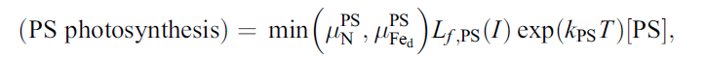
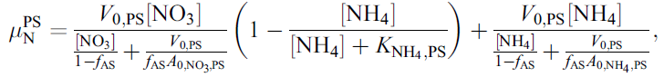






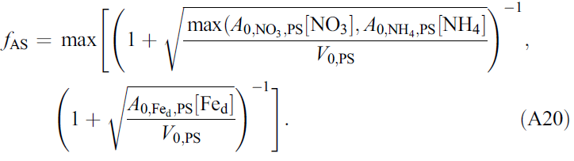
MEM (PS: Nano)
(A15)
(A16)
(A17)
0.6/86400 s⁻¹
0.6
30
30*1.0/0.1
=300
30*1.0/0.12*1.0D3
=2.5D5
0.12

Slide 3
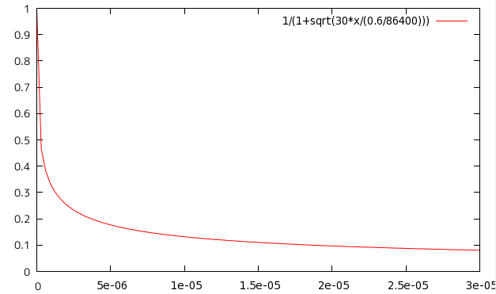
Example
if ( A_{NO3}*[NO₃] > A_{NH4}*[NH₄] ) then
30
0.6/86400
f_{AS}
[NO₃ ]
30 (umolN/L)

Slide 4
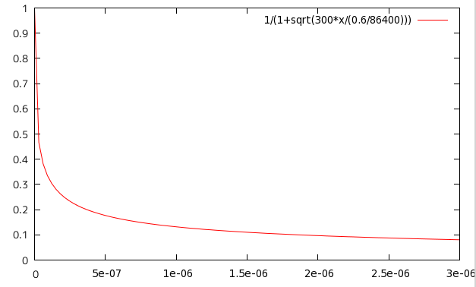
Example
if ( A_{NO3}*[NO₃] < A_{NH4}*[NH₄] ) then
300
0.6/86400
f_{AS}
[NH₄ ]
3 (umolN/L)

Slide 5
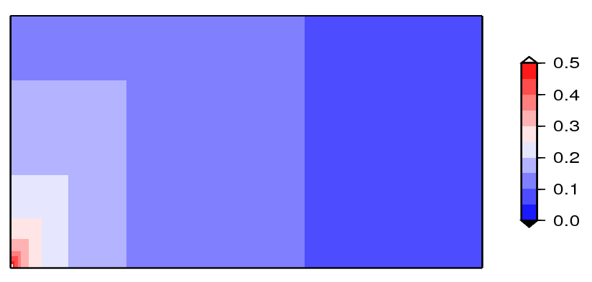
Example
1.0
[NH4] (umolN/l)
0.5
0.0
0
10
20
30
[NO3] (umolN/l)

Slide 6
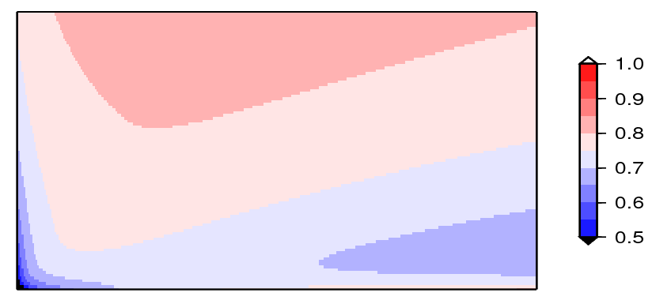
Example
(N Limitation)
0 to 1
1.0
[NH4] (umolN/l)
0.5
0.0
0
10
20
30
[NO3] (umolN/l)

Slide 7
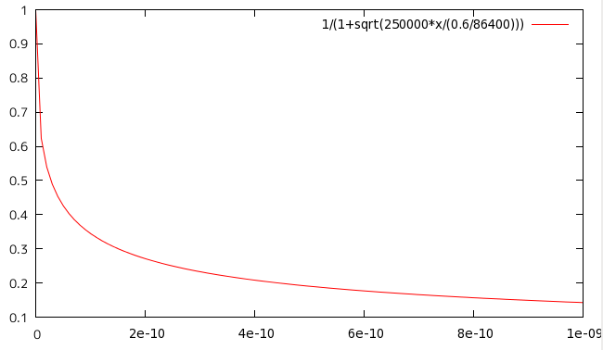
Example
If the iron part (red box) is larger than nitrate parts
2.5D5
0.6/86400
f_{AS}
[Fe ]
1.0 (nmolFe/L)

Slide 8
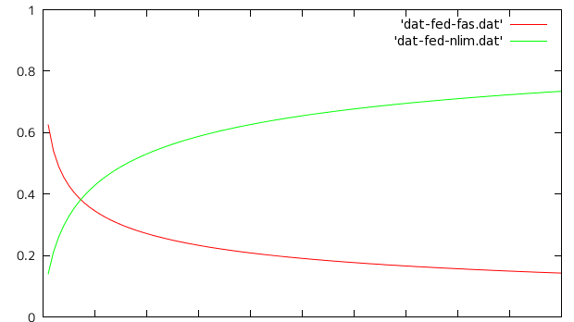
Example
(Fe limitation)=
Fe limitation
f_{AS}
0.0
0.5
1 (nmolFe/l)
[Fe]

Slide 9
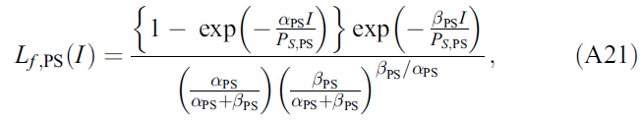
(A15)

Slide 10
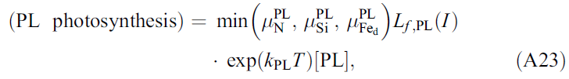











MEM (PL: Diatom)
1.2/86400 s⁻¹
1.2
10
10*3.0/0.3
=100
10*3.0/18.0
=1.6666
18.0
10*3.0/0.27*1.D3
=1.111D5
0.27

Slide 11


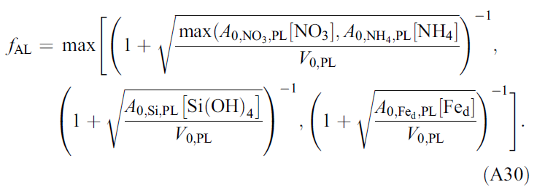

Slide 12
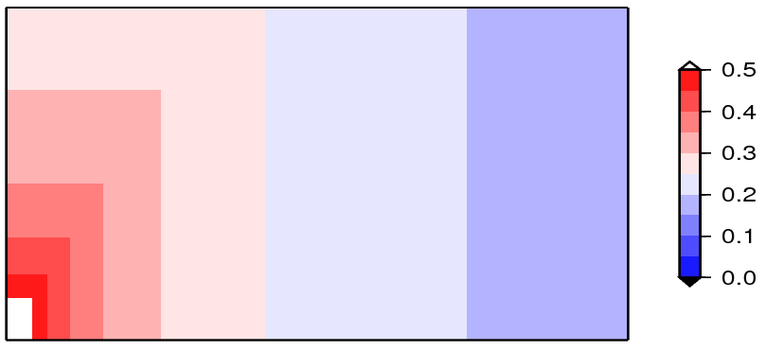
Example
1.0
[NH4] (umolN/l)
0.5
0.0
0
10
20
30
[NO3] (umolN/l)

Slide 13
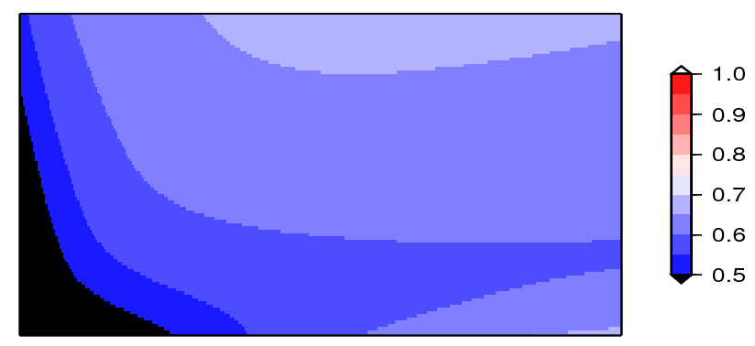
Example
(N Limitation)
0 to 1
1.0
[NH4] (umolN/l)
0.5
0.0
0
10
20
30
[NO3] (umolN/l)

Slide 14
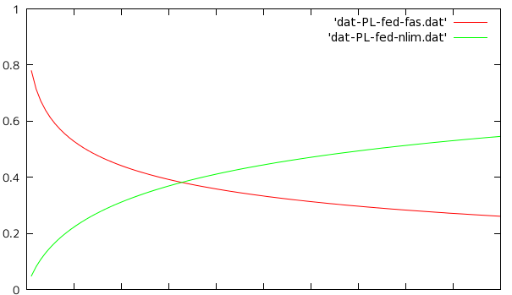
Example
(Fe limitation)=
Fe limitation
f_{AS}
0.0
0.5
1 (nmolFe/l)
[Fe]

Slide 15
